Slide 1
Meet the teachers! Miss Cousins and Mrs Dean 26.09.22

Slide 2
First of all…
What an amazing first three weeks we’ve had.
Children have settled and cracked on with Year 1 so well.
Strengths in Year 1:
Confidence and chatter
Curiosity
Good general knowledge of the world around us
Reading
Good understanding of number and place value to 10
Areas to improve:
Listening
Handwriting
Spelling
Writing numbers

Slide 3
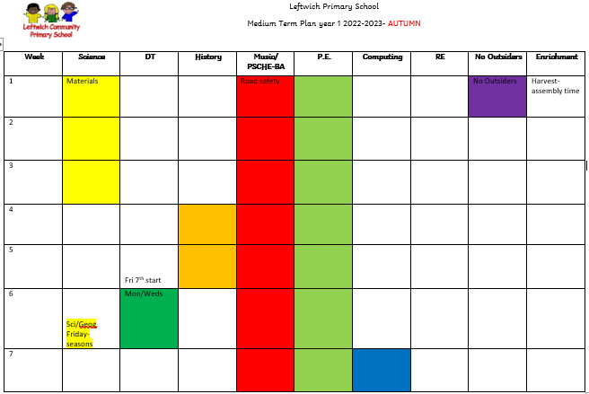
Term 1-
RWI, English (reading and writing) and Maths every morning.
Then we are blocking foundation subjects in the afternoon.

Slide 4
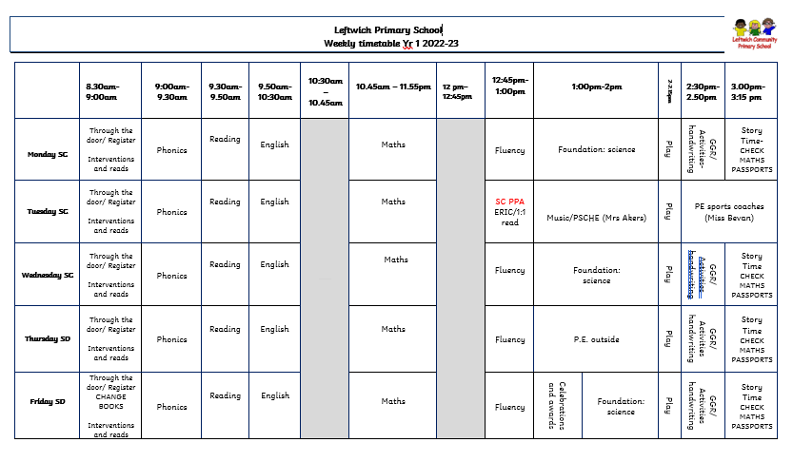
This is the timetable we have recently been following.
As the foundation unit focus changes, the afternoons will be different. E.g. change from science to history.

Slide 5
Additional Adults
Miss Eccles- Monday to Friday
(apart from Thursday afternoon).
Mrs Akers- PSCHE/Music- Tuesday afternoon 1 hour
Miss Bevan- leads P.E. Tuesday afternoon
Mrs Dean- covers Miss Eccles (Thursday afternoon)

Slide 6
Reading
Reading books are either RWI level books, or Rainbow book bands which correlate to RWI level.
Children will be assessed on their RWI sound knowledge at the end of each half term.
Children should be able to read their home books fluently – at their level.
Your child should read at home AT LEAST 3 times a week- diaries to be signed and a comment added if necessary. The diaries are checked EACH DAY and books are changed on a Friday. House points are given for children who read regularly.
10 book challenge- introduced after half term
Please encourage your child to read signs around them, menus, notes etc. Any reading is important practise!
AND, of course, bedtime stories are just THE BEST experience for your child, and for you!

Slide 7
Handwriting
Change in Year 1- print
Taught at least 3x a week
Practiced regularly- linked to RWI sounds
This font is what it should look like!

Slide 8
P.E.
Tuesday and Thursday afternoons
Miss Bevan (sports coach) to lead on Tuesdays in the hall. Mrs Dean to teach outdoor P.E. on a Thursday (this may change to a Wednesday, but we will let you know in plenty of time)
Kit is to be worn into school on these days. Children can also come in their kit if they have a sports club after school. Please make sure everything is named!
Winter kit as well as indoor kit.

Slide 9
Homework
RWI sounds- a pack will be sent home for you to practice with your child, ideally twice a week. PACKS GIVEN OUT AT MEETING.
Reading at least 3 times a week
Maths Passports-
They list a number of objectives to support the Yr 1
curriculum
The children are asked to work through the tasks
We will check the children’s progress in school and after 3
correct attempts at the objective, a sticker will be given
Maths-based online courses- Mathletics and Numbots- all codes are in reading diaries.

Slide 10
Trips / Dates
Delamere Forest- geography, seasonal change (science) and art
9th November
Visiting Davenham Church- belonging and Christmas
1st December
Christmas performance KS1-
13th December 1.30-2.30pm
14th December 6-7pm

Slide 11
Parent’s evening
18^{th or} 20th October 3.45-7.15
Chance to discuss how children have settled into Year 1 so far
More info will follow nearer the time.

Slide 12
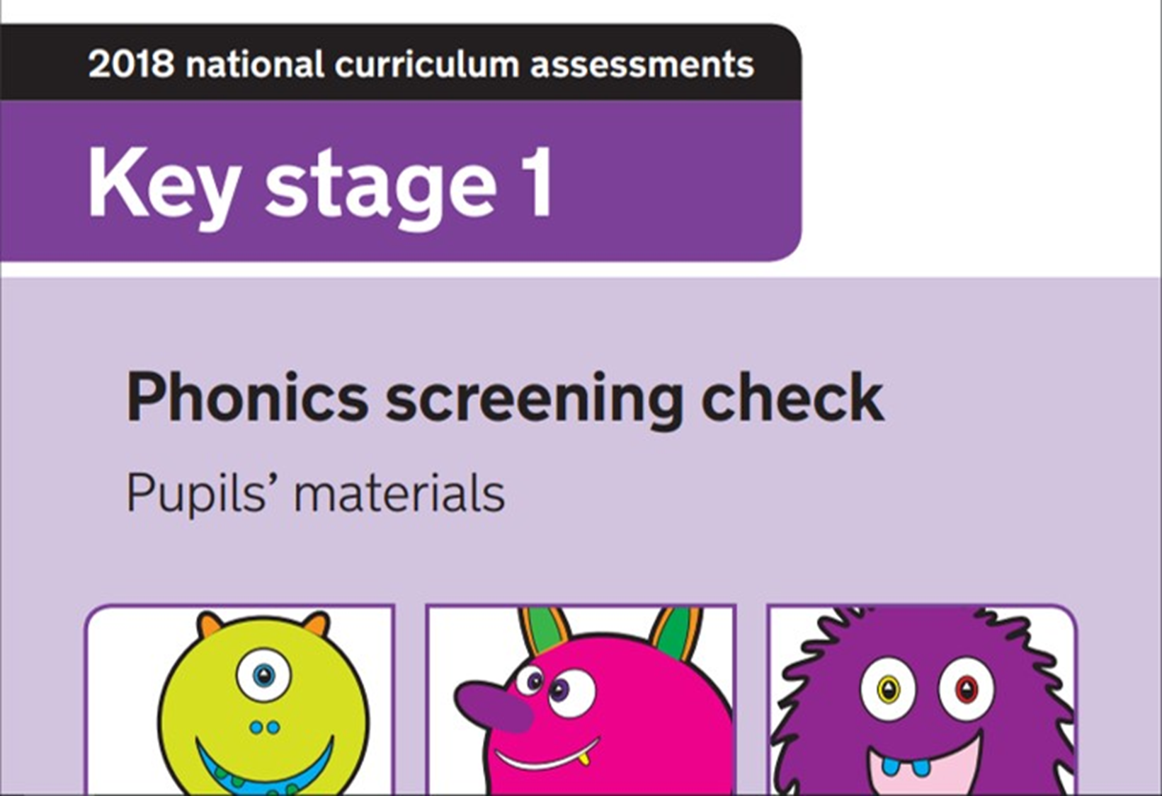
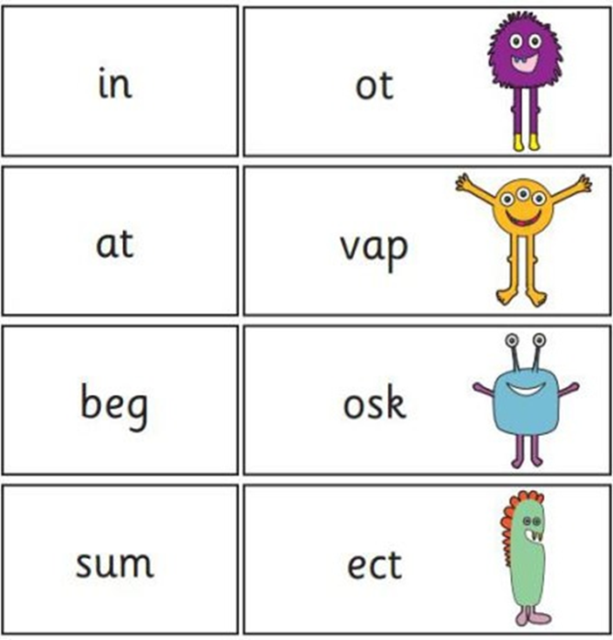
Standardised Assessment
National test usually in early June
Read real and ‘alien’ words
Covers all sounds in the phonics curriculum
Results given in end of year report

Slide 13
Please note….
123 Magic behaviour system
Reading diaries in every day
Water bottles in every day
PLEASE NAME ALL ITEMS BELONGING TO YOUR CHILD
Contact you by text, email, diary, face to face or letter
CELEBRATION FRIDAY- all star of the day children are celebrated on Face Book and photos are shared from the week
Teacher/Parent partnership- please send a note in, ring the office, catch us at the end of the day if any concerns or questions!

Slide 14
Here’s to a fantastic year !
Thanks for your support!

