Slide 1
Welcome to Leftwich Community Primary school
Wednesday 14th June 2023

Slide 2
Introductions
Head Teachers
Mrs Harrison
Mrs Guy
Mrs Dean
Mrs Dutton
Reception Teachers

Slide 3
Head Teachers' Welcome
Welcome and introductions from the Head Teachers
Website – 2023 New Reception – information specific to new starters. Password - Reception2023
Website – general information, including Northwich Schoolwear for uniform
School lunches – Healthy packed lunch or free school meal – don't worry about fussy eaters!
Communication – text system, email, face to face, twitter, Facebook
Transition this year.

Slide 4
Pupil Premium
Pupil Premium – what is this? Not to be confused with Universal Free School Meals!
Some of the ways in which we support parents who are entitled to the Pupil Premium Grant – subsidised school trips, uniform, junior snack, clubs, residential visits...
Pupil Premium Registration form
Family Support Worker

Slide 5
The Homepack – what is in it?
Milk provided for snack
Fruit provided for snack – can bring your own healthy alternative if you want
Lunch is free to Reception and Years 1 and 2 children.
Most children have lunch in school
Please ensure you tell us who is picking up your child. If we don’t know them, we will stop them from going with them
Uniform – please ensure it is name – sew-in/iron on name labels are best
Expect uniform to get dirty/marked. It’s a working uniform.
Early Years Foundation Stage - first year of the new curriculum – read through how you can support your child

Slide 6
Early Years Foundation Stage Curriculum
Early Years Foundation Stage Curriculum
It’s a continuation of work from your child’s previous setting
Seven areas which are split into Prime Areas and Specific Areas
Prime Areas are fundamental to your child’s learning. They work together and support development in all other areas of learning
The Prime areas are:
- Personal, Social and Emotional Development.
Communication and Language.
Physical Development
Specific Areas include essential skills and knowledge for children to participate successfully in society.
The Specific Areas are:
-Literacy
Mathematics
Understanding of the World
Expressive Arts and Design

Slide 7
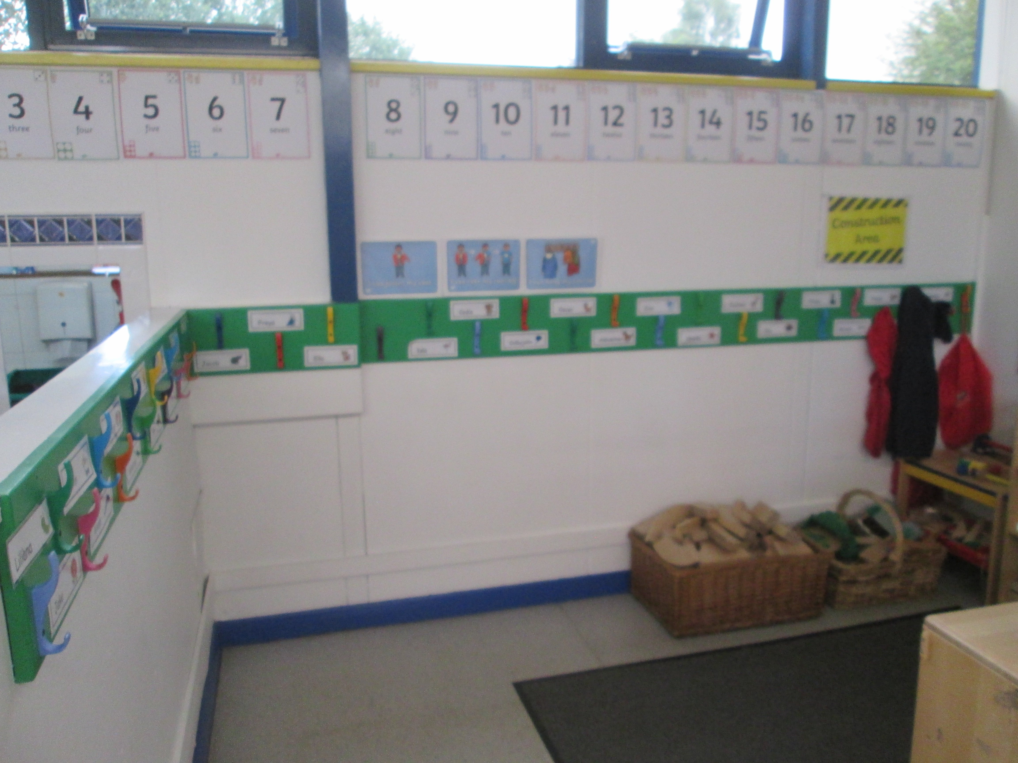
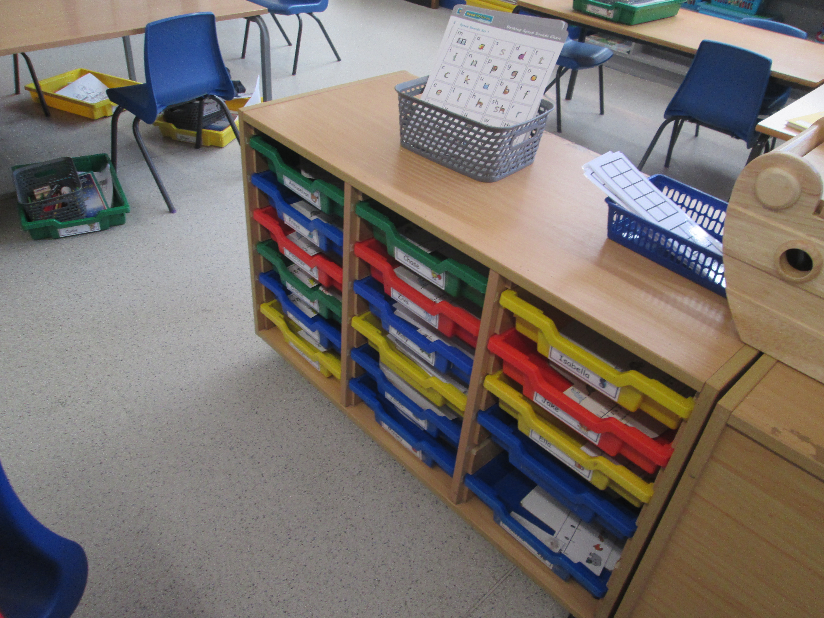
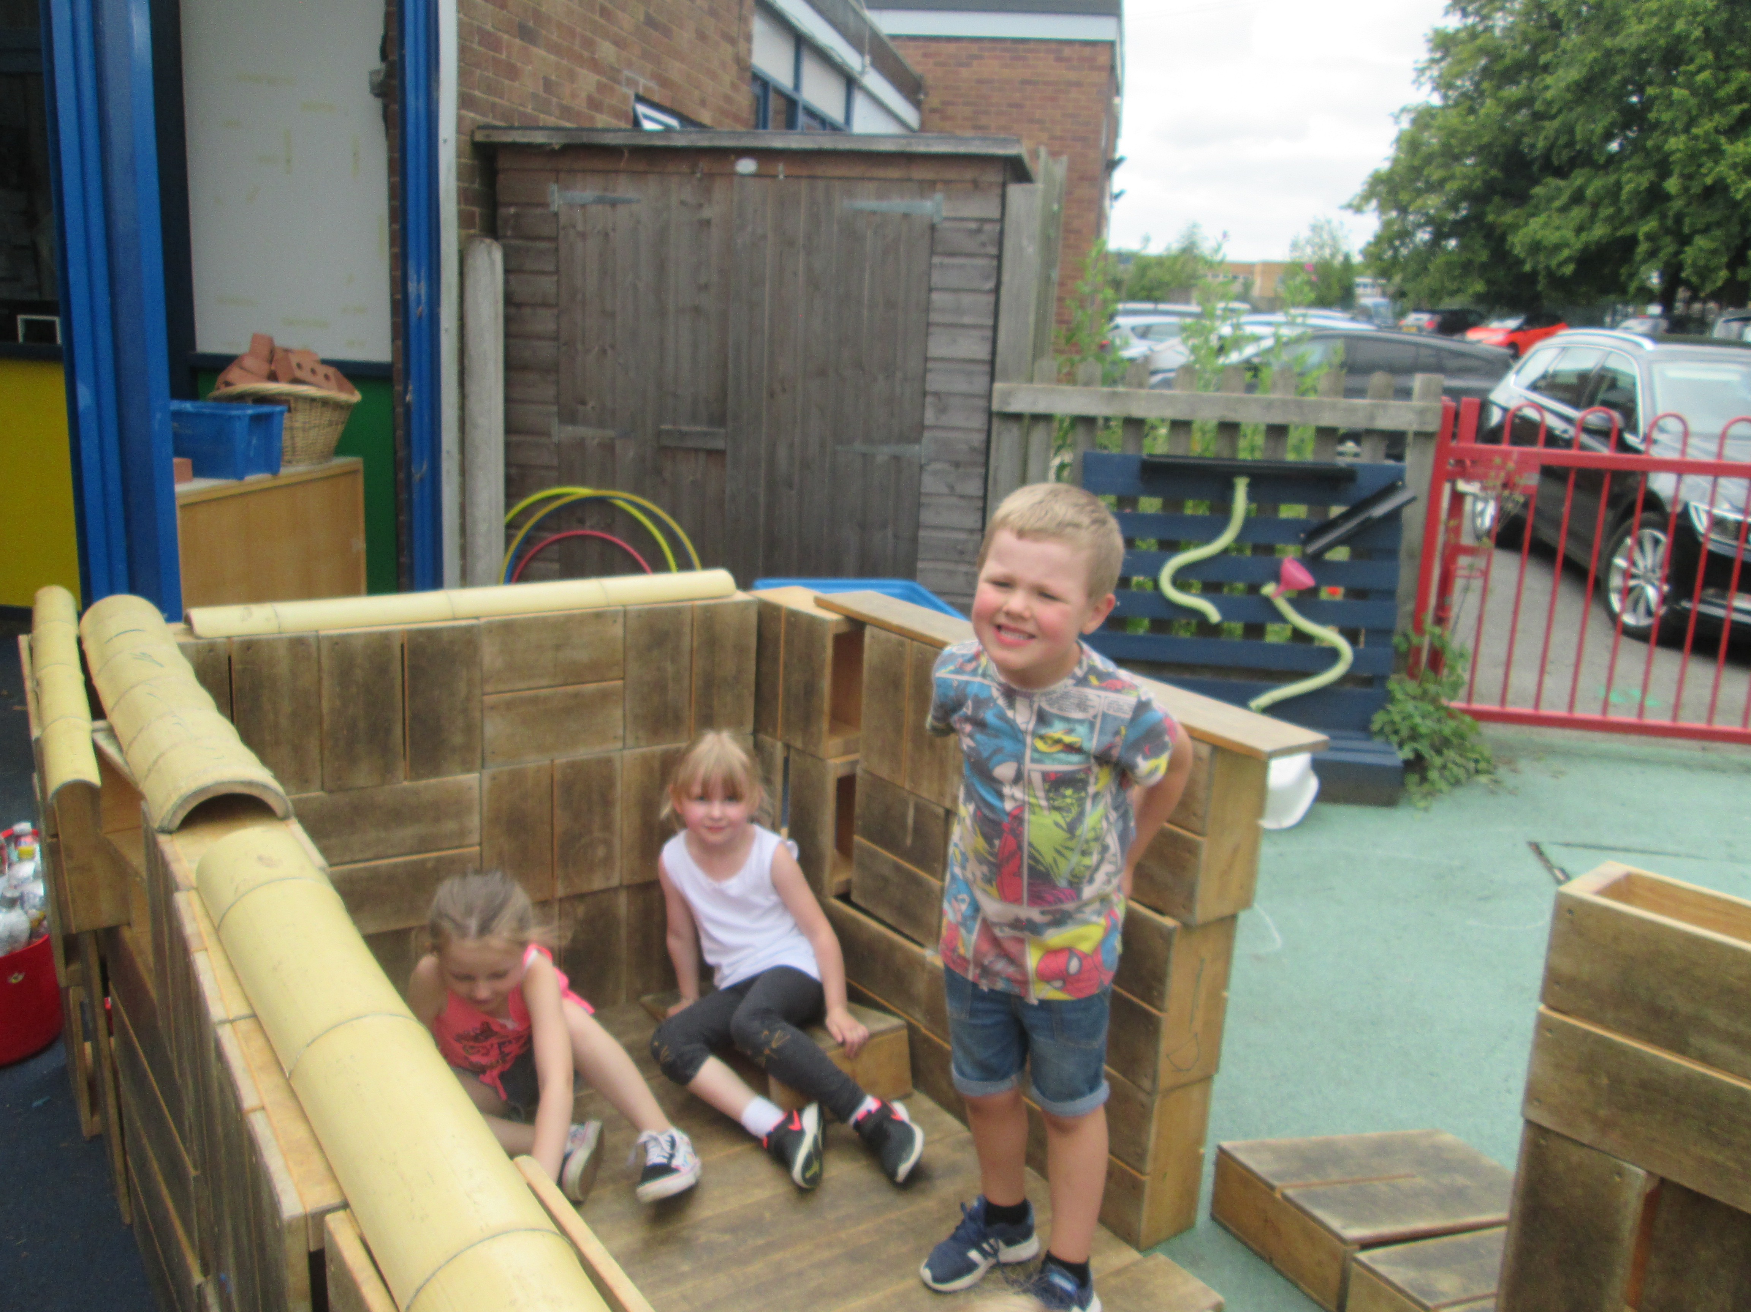
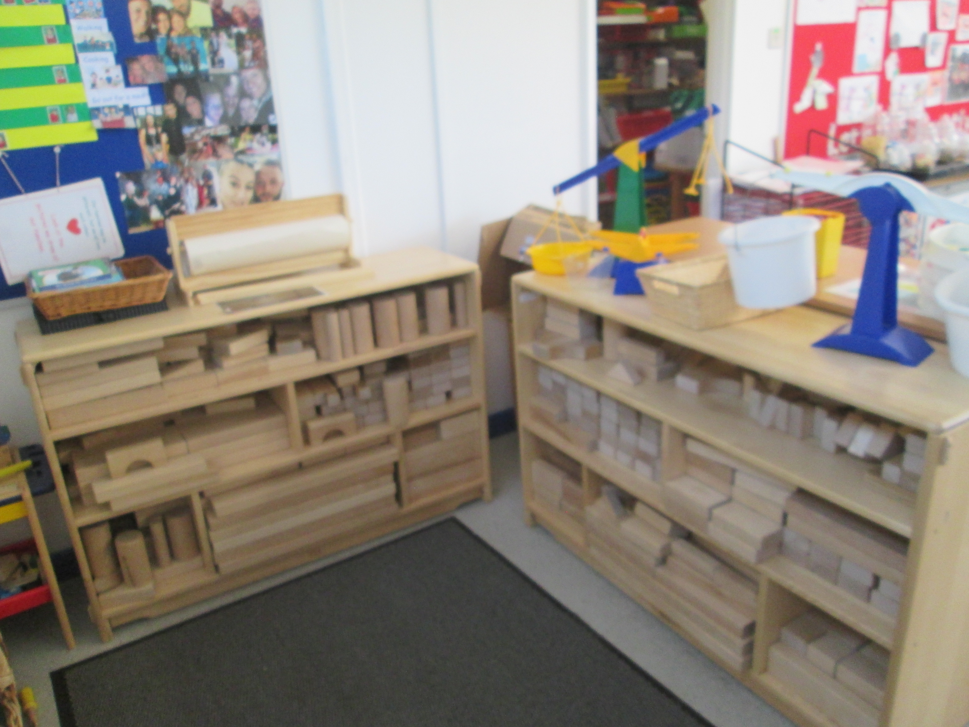
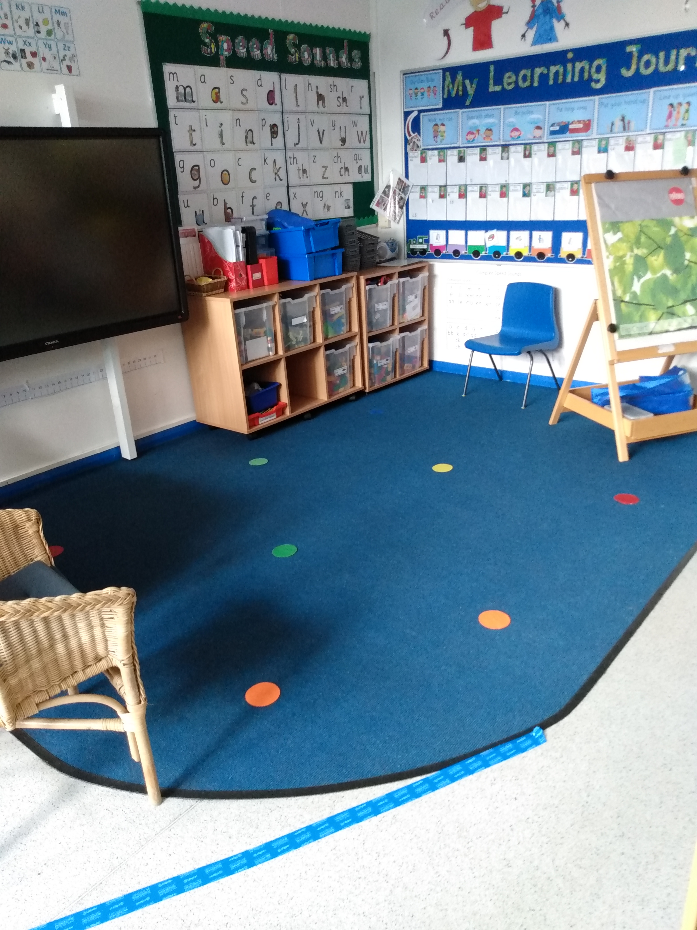
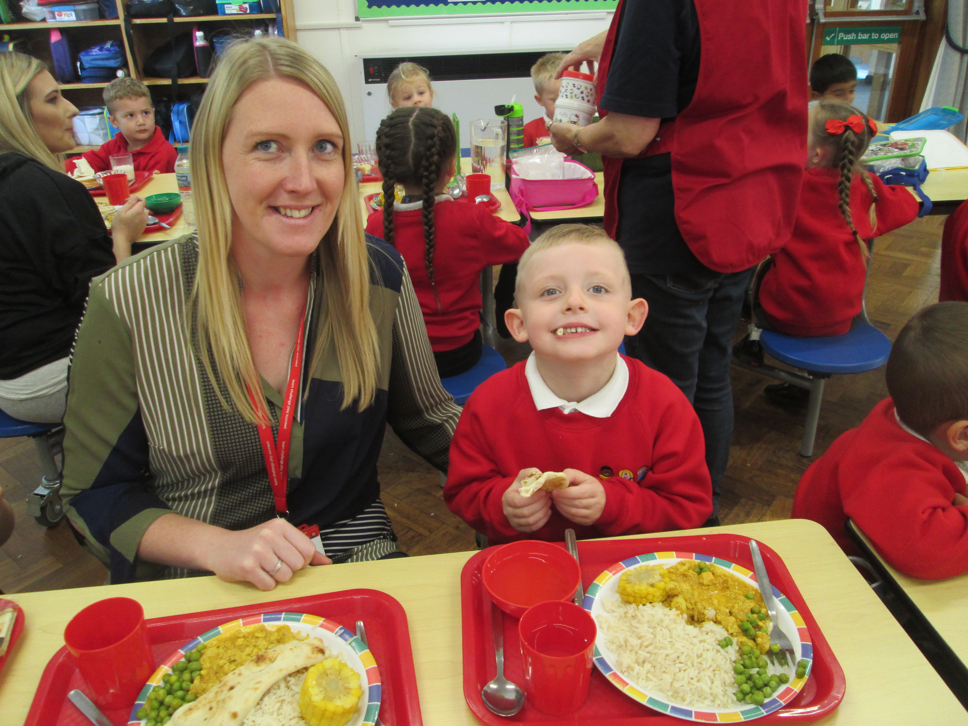
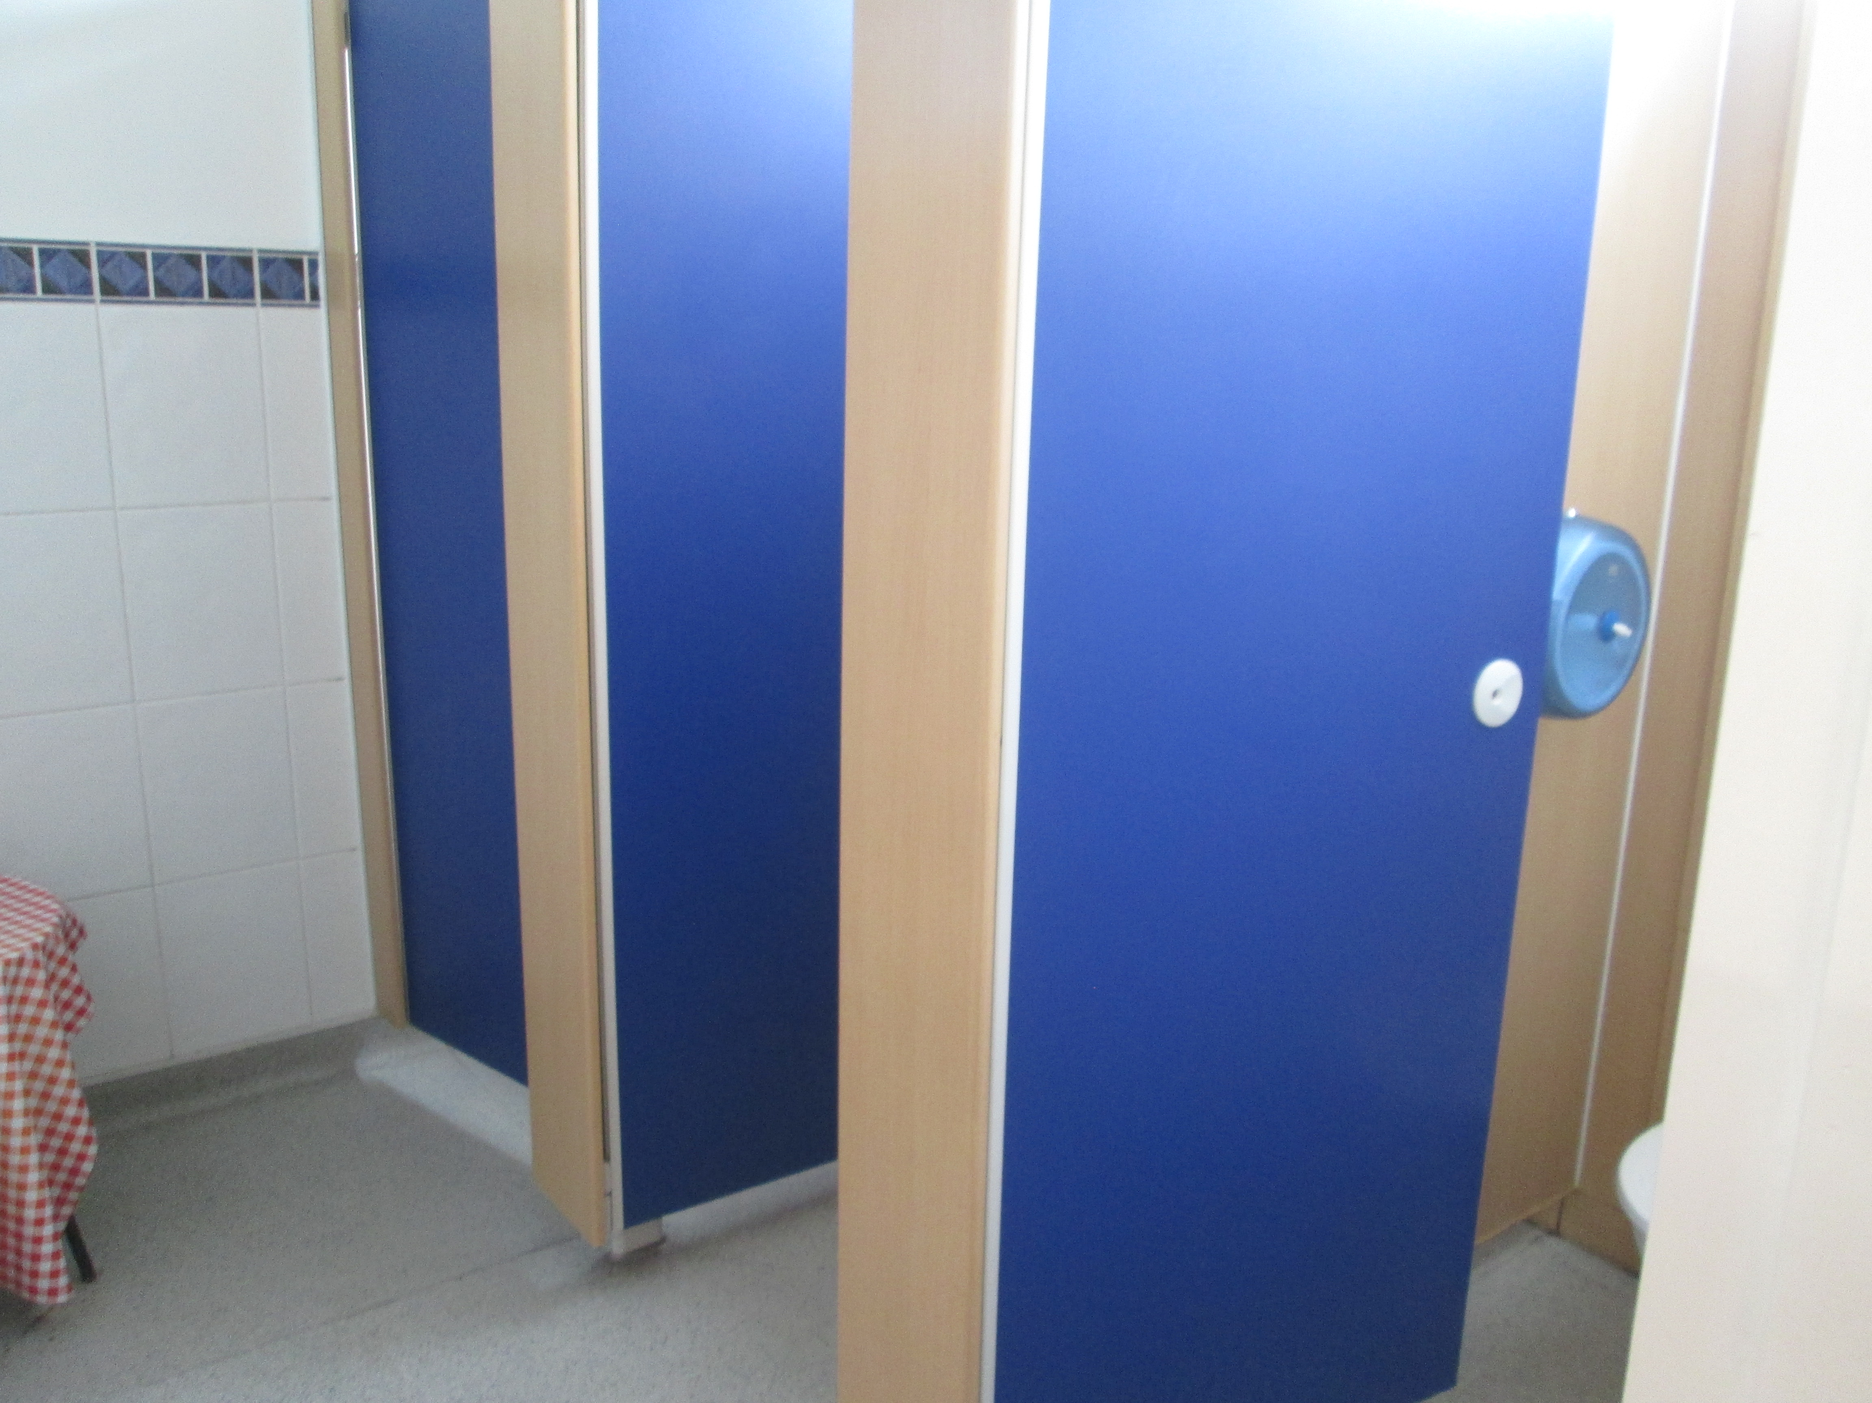
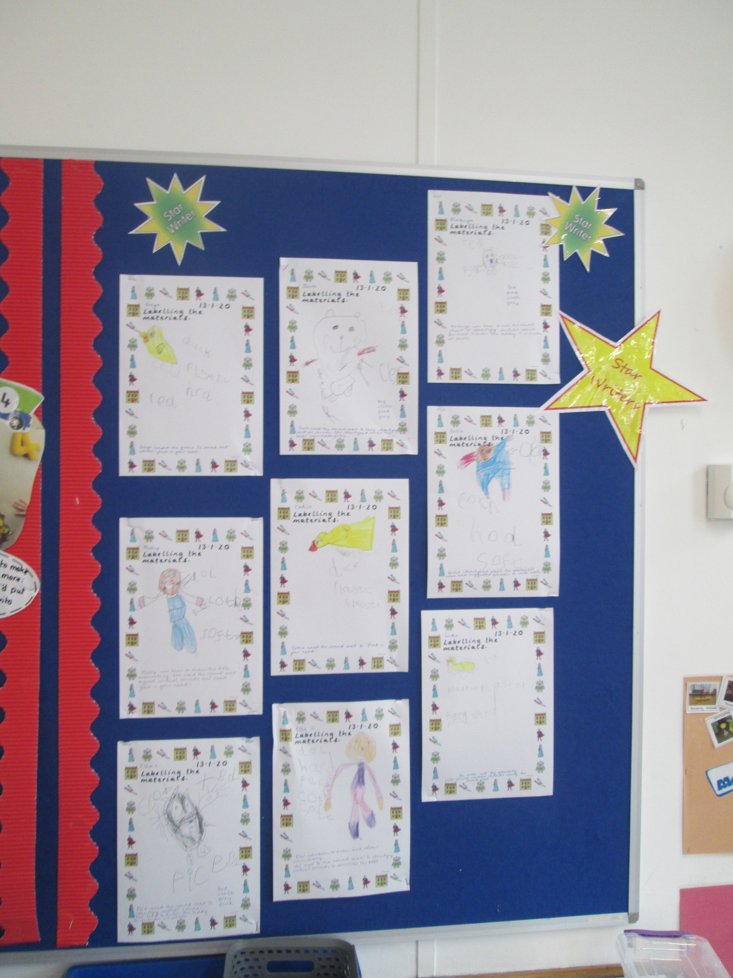
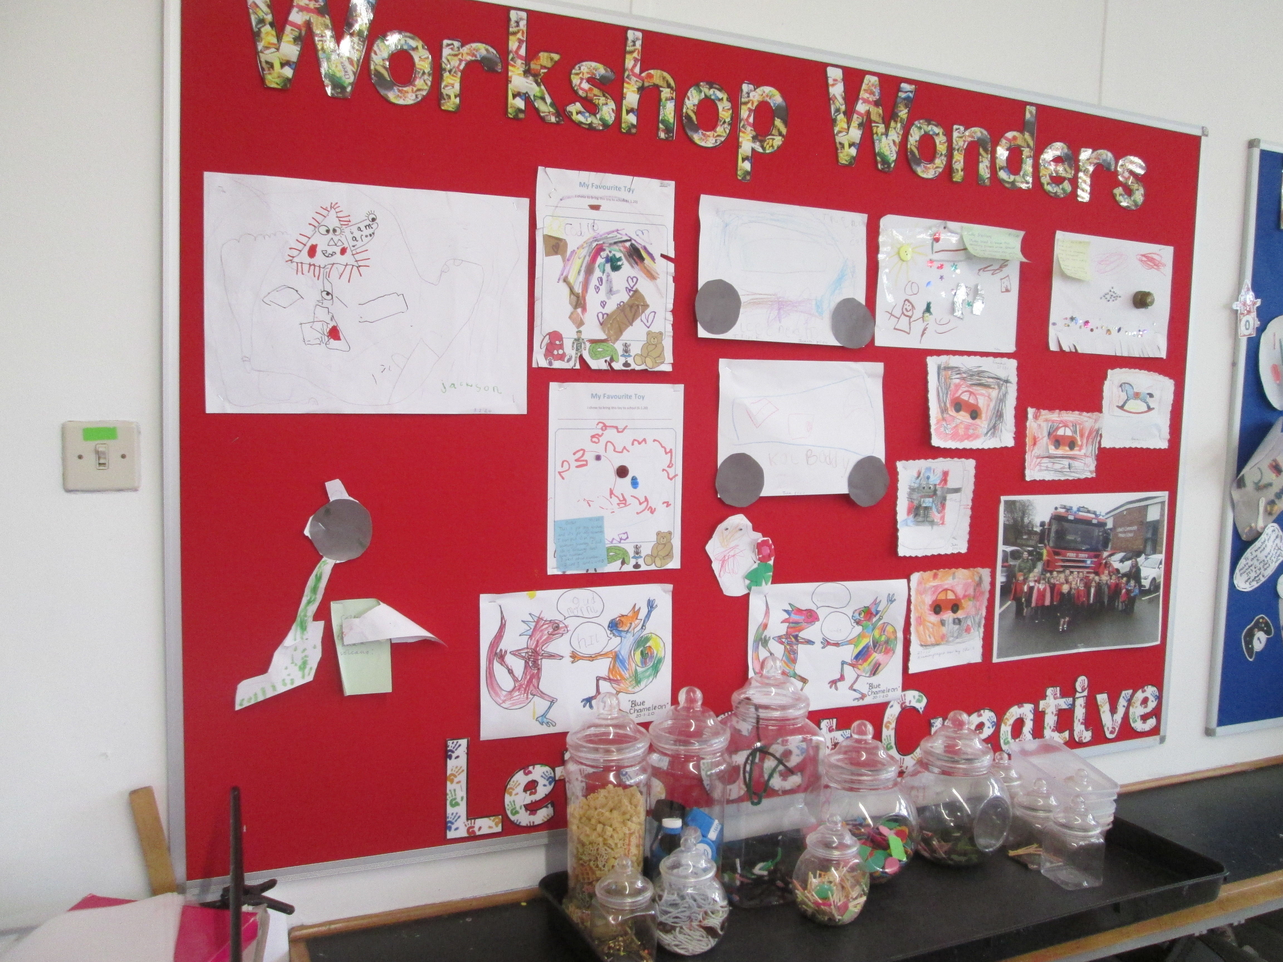
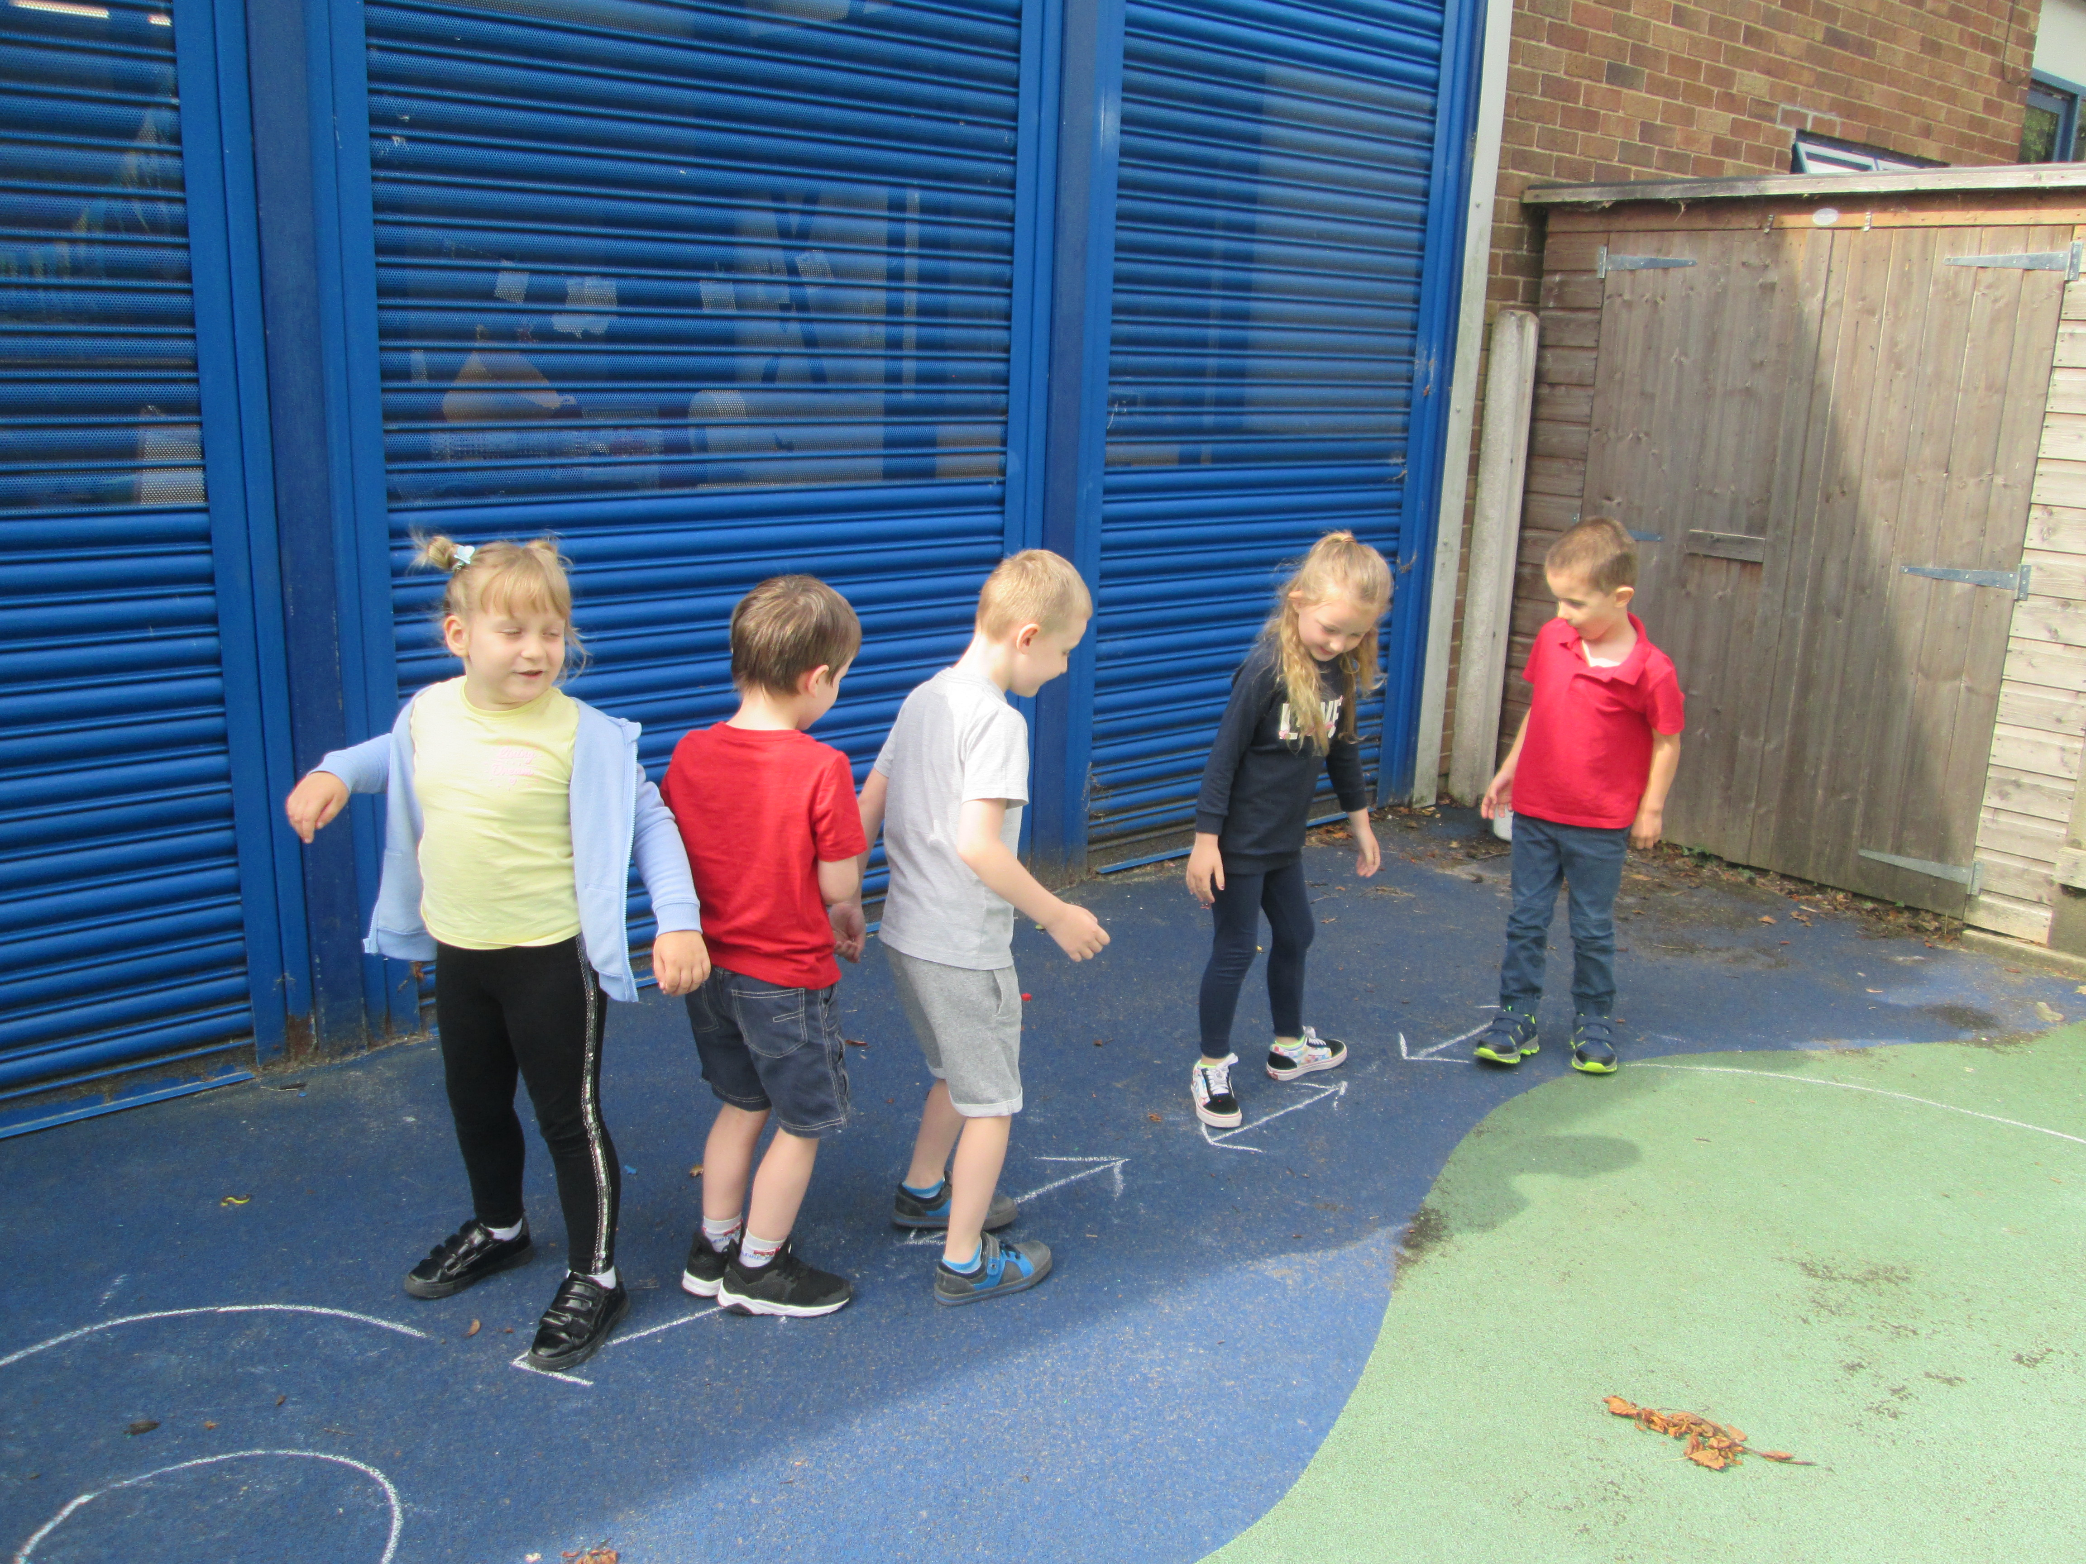
A look around the classroom – to show the different areas to support our curriculum
The cloak room
Trays
Building Area
Carpet Area
Lunch time
Toilet Area and sink area
Writing Area
Outdoor Area
Workshop

Slide 8
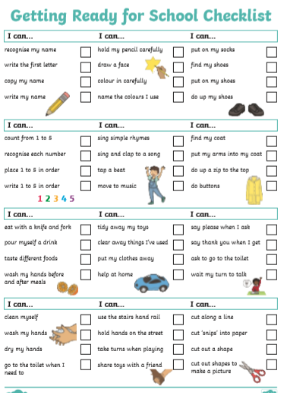
Other things in your pack
Please could you fill this in and sent back to school.
It will help us to learn about your child.
This is for you to have a look at and ideas for you to work upon before your child comes to school
Other sheets – such as data, permission, medical etc. Fill in and send back

Slide 9
Home Visits and Visits to School
In order to meet your child in their own setting before they come to school, we are hoping to do a home visit in July. This can be a doorstep, garden or home visit. You can either sign up at the 'Stay and Play session, ring in to book one or we will send you one. We will send you further information about date and times.
A home visit will allow you and your child to meet us in their own setting. You will be able to ask questions and we will be able to learn about your child – their likes/dislikes
They can show us their favourite toys, tell us about their favourite stories, show us their pets, bedrooms – whatever they like!
As we learn about your child, we will use this information to help us enhance the classroom for when they start school in September
If your child does not go to Small World nursery, please tell us now which nursery they go to, and we will arrange meetings with those nurseries

Slide 10
Thank you
Thank you for all coming to our meeting
We hope you enjoyed it
Any questions

