Slide 1
ReadWriteInc. in
Reading and Writing

Slide 2
The importance of phonics:
The Government believes that phonics is very important.
Phonics is the breaking down of words into sounds.
This helps with reading and writing because it helps children to spell.
Children are assessed in reading and writing early learning goals in Reception, take the phonics test in Year 1 and are assessed in reading and writing during SATs exams in Year 2 and Year 6.
Reading and writing are interlinked and they enable children to access all subjects.

Slide 3
What is ReadWriteInc.?
How will it help my child to read?
How will it help them to write?
What will happen in school?
What will my child come home with?
How can I help my child?

Slide 4
What is ReadWriteInc.?
A phonics programme.
Uses pictures and rhymes/sayings.
Regularly assesses children.
Move in groups.
Exactly matched sounds to books.
Repetition.
Sound/saying write it book containing sound writing activities.

Slide 5
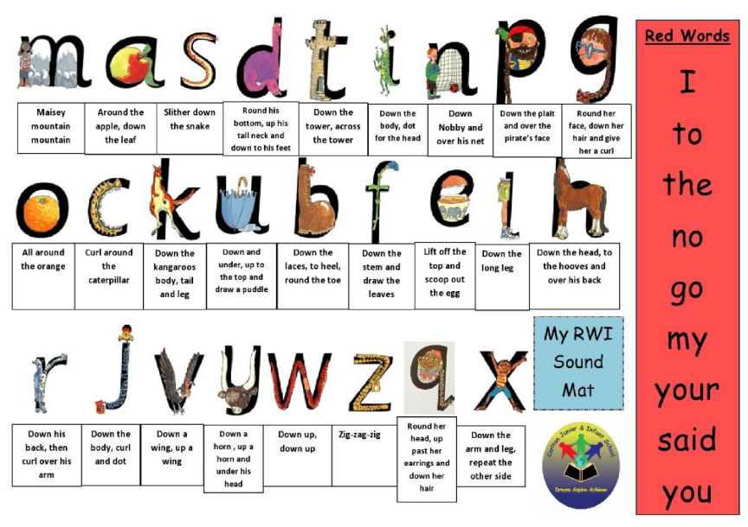
How will it help my child to read?
Regular assessment.
Pictures and rhymes.
High frequency words and tricky words.
Repetition.
Well matched books.

Slide 6
We will also….
Read a wide variety of books to them.
Give the children ‘sharing’ books to take home.
Give children access to the school library.
Arrange for the Library Van to visit.
Organise literary events, such as World Book Day.
Encourage the children to visit their local library.

Slide 7
How will it help them to write?
Fred talk and Fred fingers.
Practising basic skills using familiar words.
High frequency words and tricky words.

Slide 8
We will also….
Introduce the children to high quality texts through Pathways.
Encourage them to write at length.
Introduce a wide range of vocabulary.
Organise events that encourage imagination and writing, like National Poetry Day.
Run competitions in the library.

Slide 9
What will happen in school?
In Reception the children will take part in RWInc. sessions each day.
New sounds.
Tricky words and high frequency words.
Progressing to written activities relating to matched book.
In Year 1 the children will take part in RWInc. sessions 3 times a week and Pathways writing 2 days a week.

Slide 10
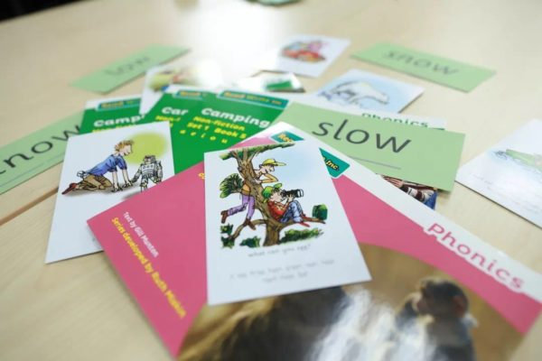
Some Year 2 children will take part in RWInc. Sessions each day.
Some Year 2 and Year 3/4 children will take part in ‘keep up’ sessions three times a week.

Slide 11
What will my child come home with?
A sound book or a ‘book bag’ book.
The same ‘book bag’ book for 3 nights.
A ‘sharing’ book.

Slide 12
How can I help my child?
Read the RWInc. book 3 times. These books match your child’s phonic ability and are designed to improve fluency.
Your child should read their ‘book bag’ book to you.
Encourage your child to point to each word as they read and point out capital letters, full stops, spaces and the difference between letters and words.
Praise, praise, praise!
Can you sound out the word with Fred fingers?
Use pure sounds: www.ruthmiskin.com/en/resources/sound-pronunciation-guide/
What does the word start with?

Slide 13
If your child is stuck, wait 10 – 15 seconds before asking if they can blend the sounds using Fred talk.
If they’re really stuck, encourage them to read to the end of the sentence and come back to the word.
You should read ‘sharing’ books to your child, so they can hear fluent reading with expression.
Discuss all new vocabulary.
Pause to discuss the story and discuss the story again at the end, with both ‘book bag’ and ‘sharing’ books.

