Slide 1
What is happening
this week?
How does it make you feel?
Can you describe it
in your own words?
1
2
3
What are your initial thoughts?
Share your thoughts
and listen to others
Introduce further
discussion points
• I think
• I feel
• I prefer
• I know
• I believe
• The best thing about
• The worst thing about
Has your opinion changed after listening to others share theirs?
• I respectfully disagree
• I see your point but
• Without doubt
• I see what you are trying to say but
• Referring back to your point
• Everyone knows that
• It is clear
• Inevitably
• It is obvious that
Sentence openers for further discussion and debate.
Think about both reasons for and against your opinion/argument.
Do you have different opinions?

Slide 2
This week’s story looks at events in…
N
o
r
t
h
Am
er
i
c
a
North America
Europe
Asia
Africa
South America
S
o
u
t
h
Am
er
i
c
a
Oceania
Antarctica

Slide 4
My
opinion
I think…
I feel…
I prefer…
I am convinced that…
I know…
I believe…
My view is…

Slide 5
This week’s story
and big question
This week’s vocabulary

Slide 6
What questions do you have?
What do you think?

Slide 7
How do you feel?
What questions do you have?
How do you feel?
What do you think?

Slide 8
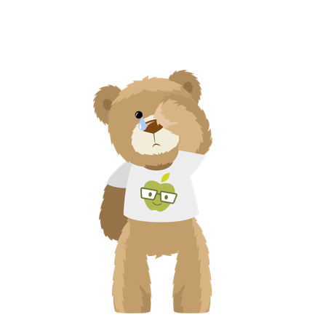
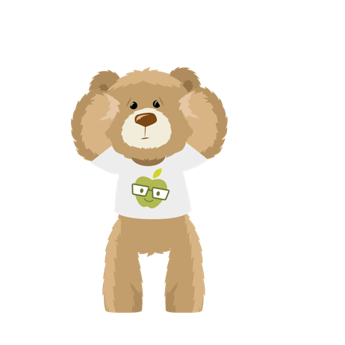
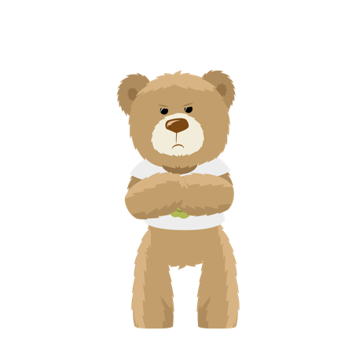
How do I feel?

